Slide 1
Proposed Content
Title: Effective Data Visualization for Actuaries
Session Description:
As actuaries, we are expected to understand the structure and rationale behind complex statistical models. Beyond that, we need to evaluate. whether one model is preferred over another in a well-defined business context. Finally, these conclusions must be shared with stakeholders who are then expected to digest and support the actuary's conclusions. Although data visualization is often touted as having maximal benefit for the last step of the process, we contend that it provides value throughout
In this session, Brian Fannin and Jordan Bonner will highlight key actuarial concepts and exhibits that can be better understood through data visualization. R’s `ggplot2` package will be used to create exhibits that allow for a deeper level of understanding and intuition. By growing comfortable with the value and mechanics of visualization at all stages of the analytics cycle, actuaries will become more facile in communicating with any stakeholder at any stage.
Learning Objectives:
Unlock a deeper understanding of complicated concepts through data visualization
Leverage R’s `ggplot2` package to create compelling actuarial exhibits
Restructure data visualizations to tell the right story for your audience
To Be Removed. For Reference Only.

Slide 2
Ideas for Interactivity
Familiarity with R
“Which chart is easier to interpret”
Test Bar/Line bias (https://bit.ly/3ymQ1eE)

Slide 3


Slide 4
Effective Data Visualization for Actuaries
Jordan Bonner
Brian Fannin

Slide 5

Effective Data Visualization for Actuaries
Jordan Bonner
Brian Fannin

Slide 6
Agenda
Seeing is Believing
Decoding Complexity
The Power of Persuasion

Slide 7
Seeing is Believing

Slide 8
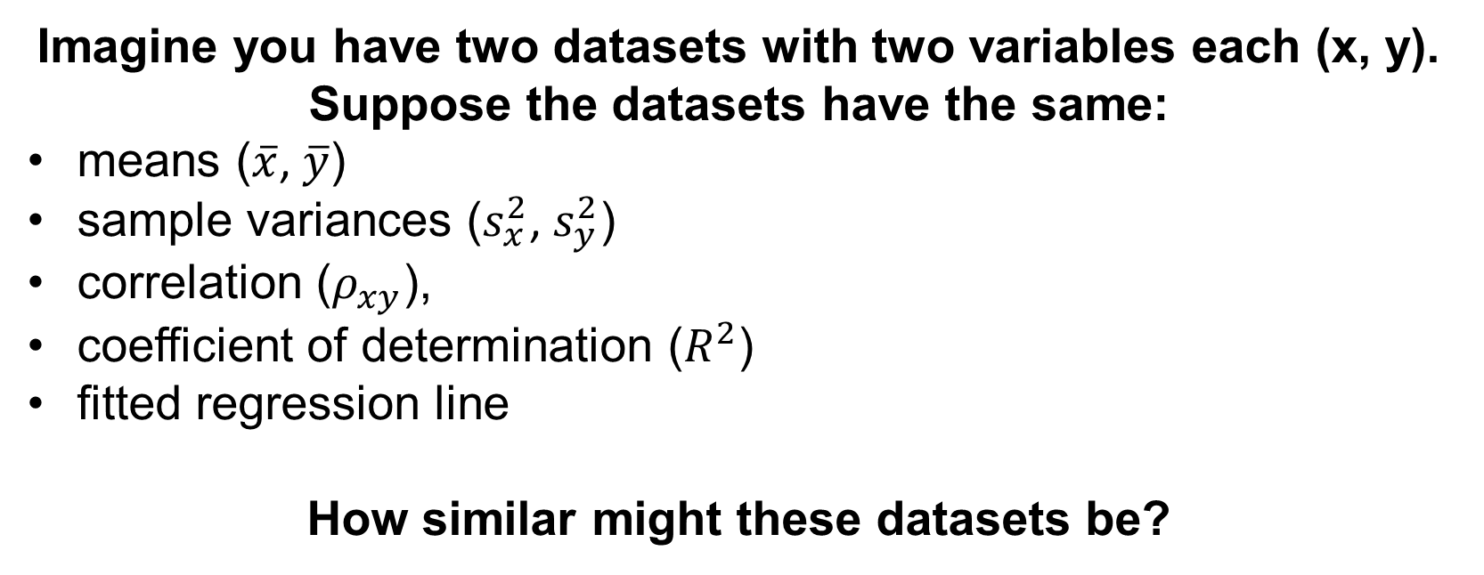
Seeing is Believing
Imagine you have two datasets with two variables each (x, y). Suppose the datasets have the same:
means ($\overline{x}$, $\overline{y}$)
sample variances ($s_{x}^{2}$, $s_{y}^{2}$)
correlation ($ρ_{xy}$),
coefficient of determination ($R^{2}$)
fitted regression line
How similar might these datasets be?

Slide 9
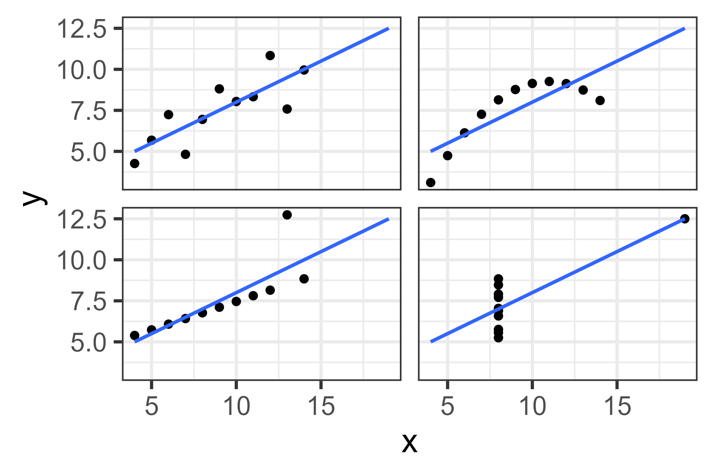
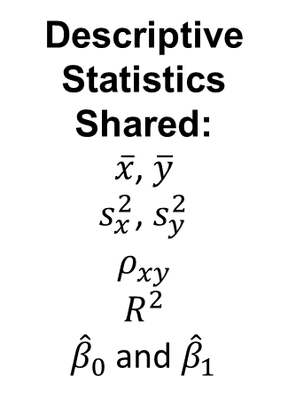
Anscombe’s Quartet
Descriptive Statistics Shared:
$\overline{x}$, $\overline{y}$
$s_{x}^{2}$, $s_{y}^{2}$
$$ρ_{xy}$$
$$R^{2}$$
${\hat{β}}_{0}$ and ${\hat{β}}_{1}$

Slide 10
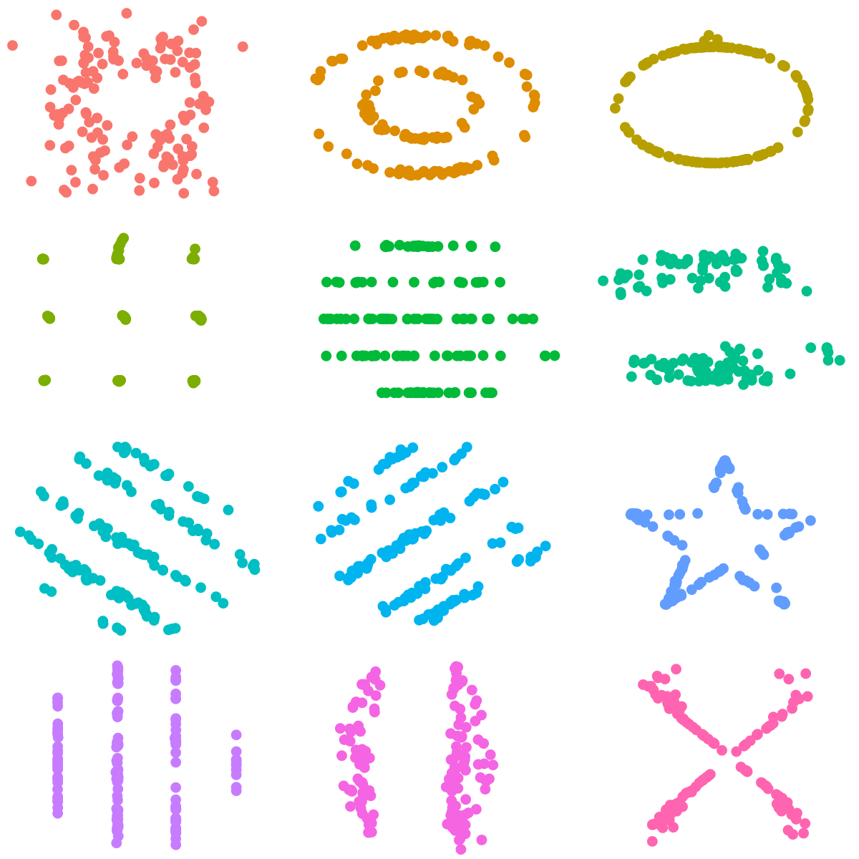
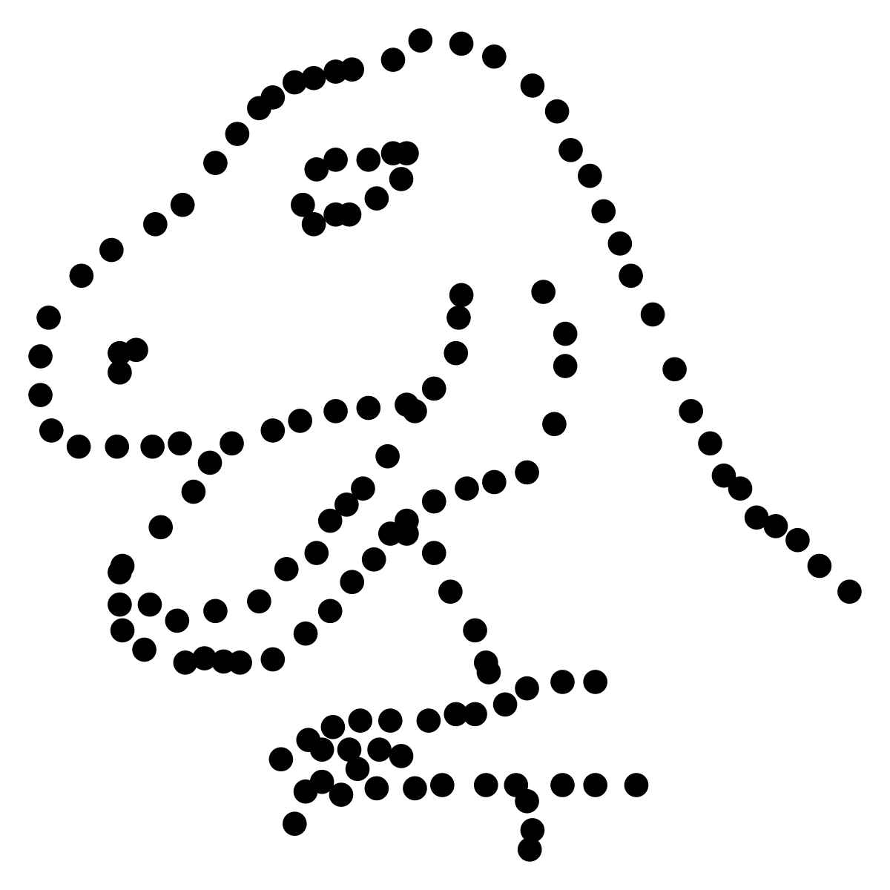
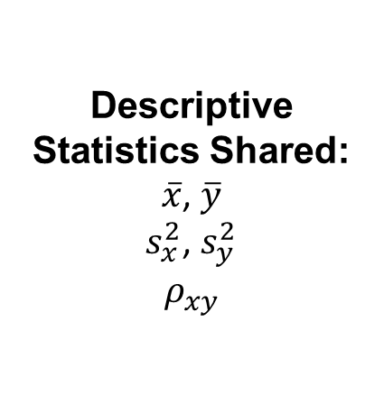
The Datasaurus Dozen
Descriptive Statistics Shared:
$\overline{x}$, $\overline{y}$
$s_{x}^{2}$, $s_{y}^{2}$
$$ρ_{xy}$$

Slide 11
Why Seeing is Believing
Better Pattern Identification
Identifying Outliers
Spotting the “Big Picture”
Memory Retention

Slide 12
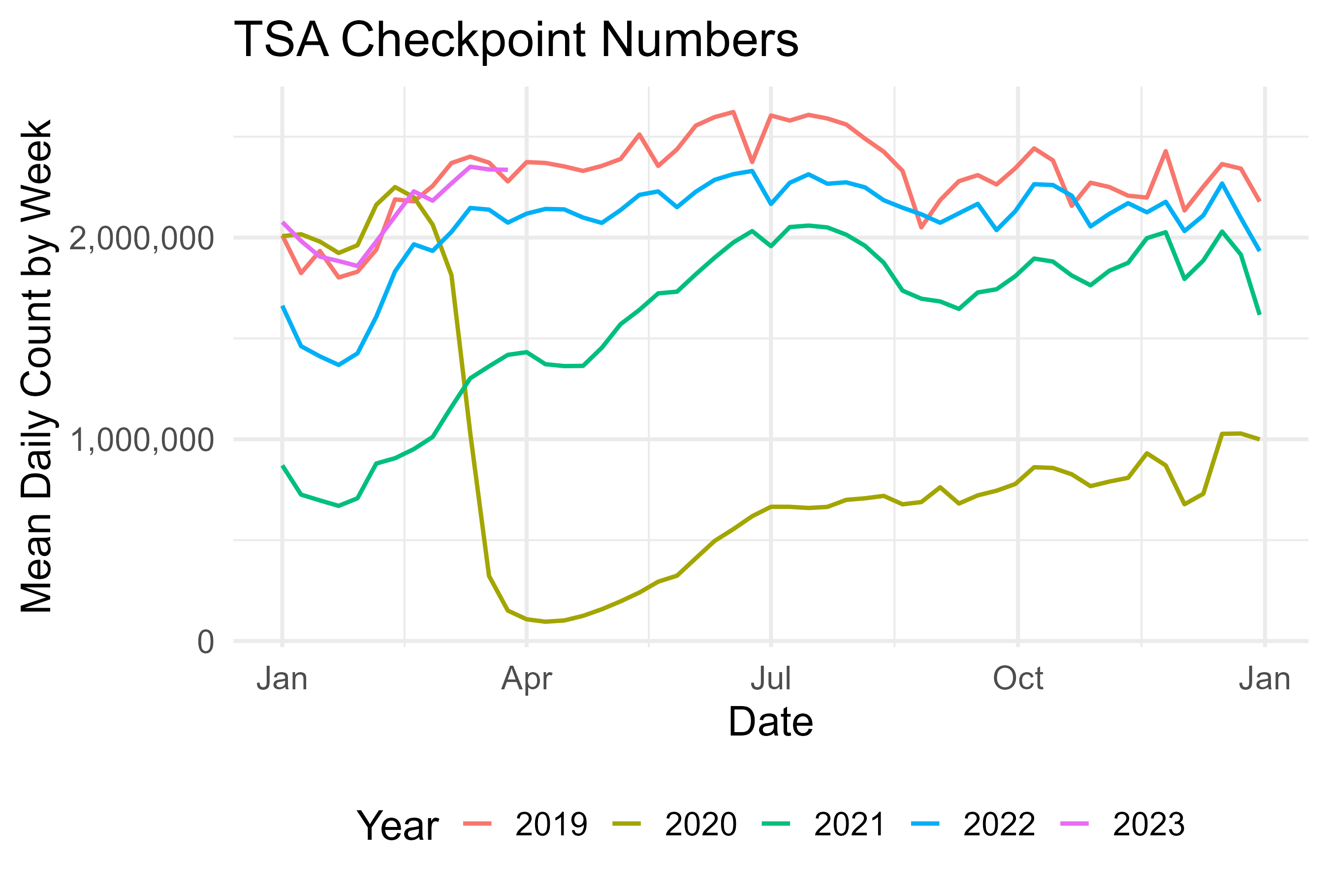
Better Pattern Identification - Seasonality

Slide 13
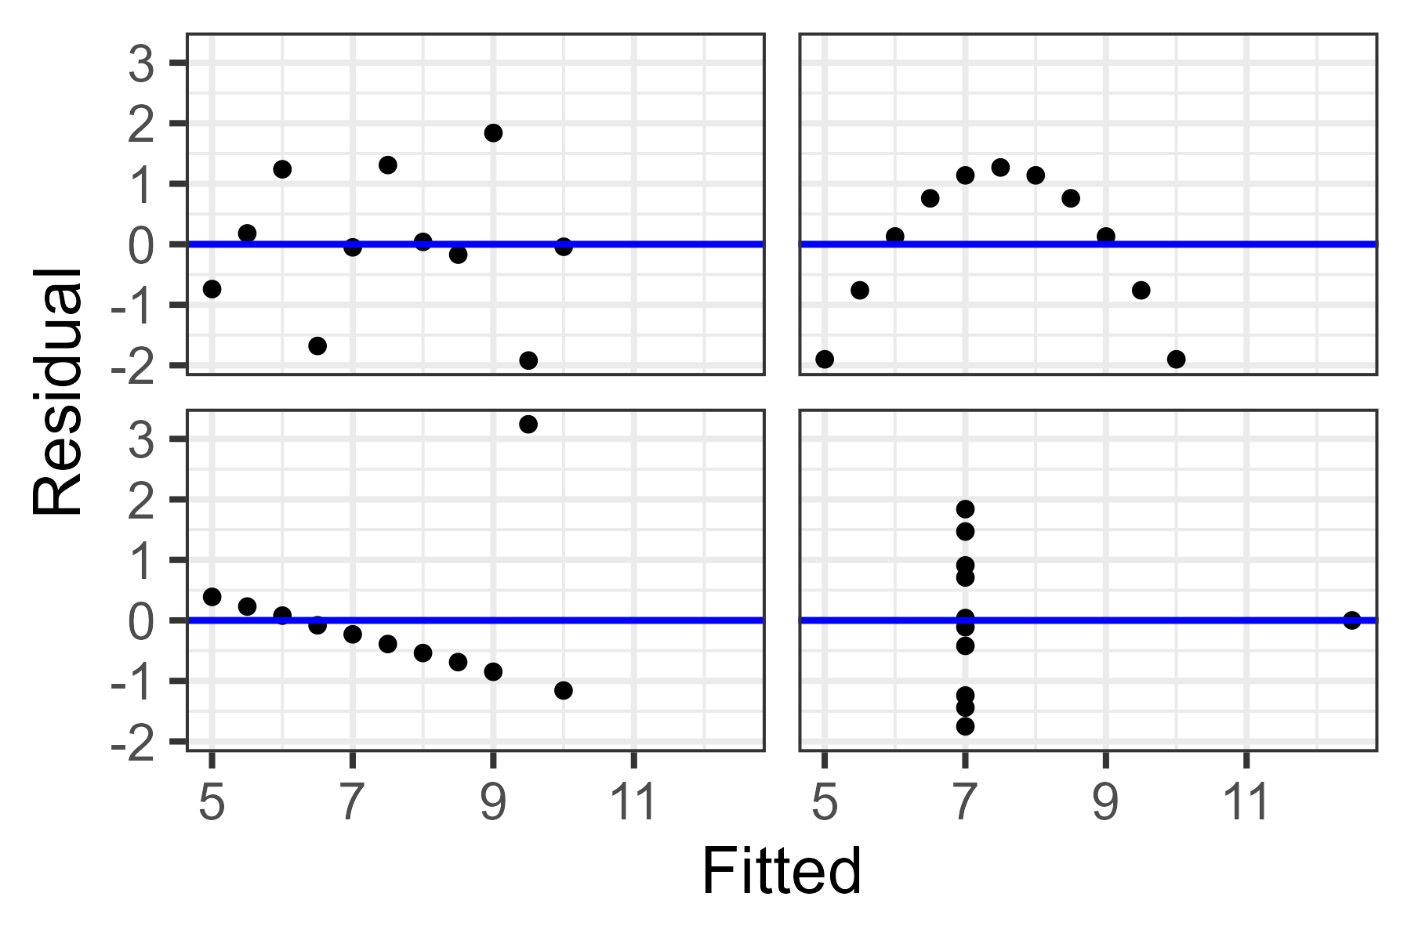
Identifying Outliers – Residual Plots

Slide 14
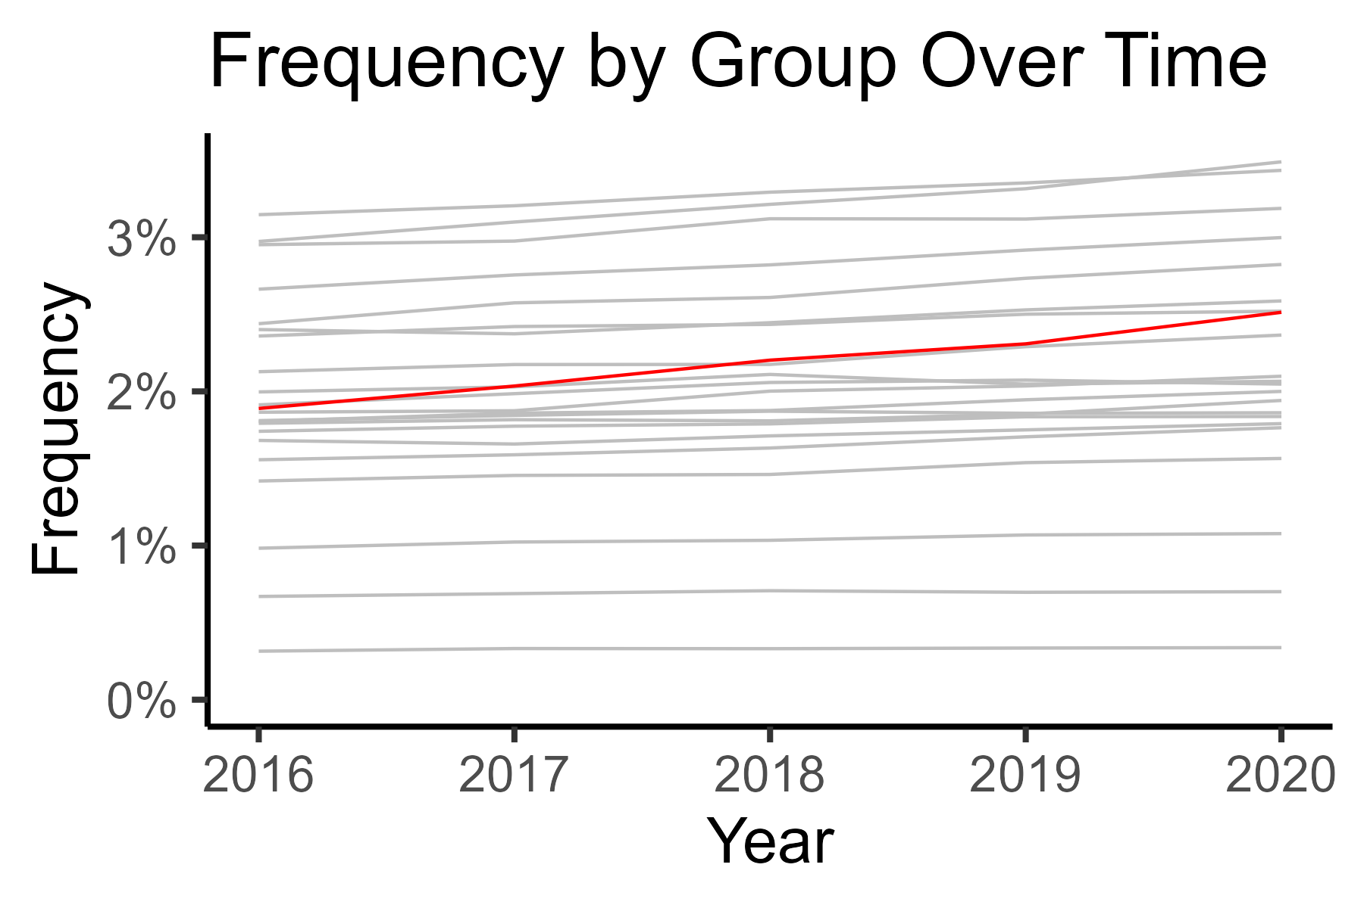
Spotting the “Big Picture”

Slide 15
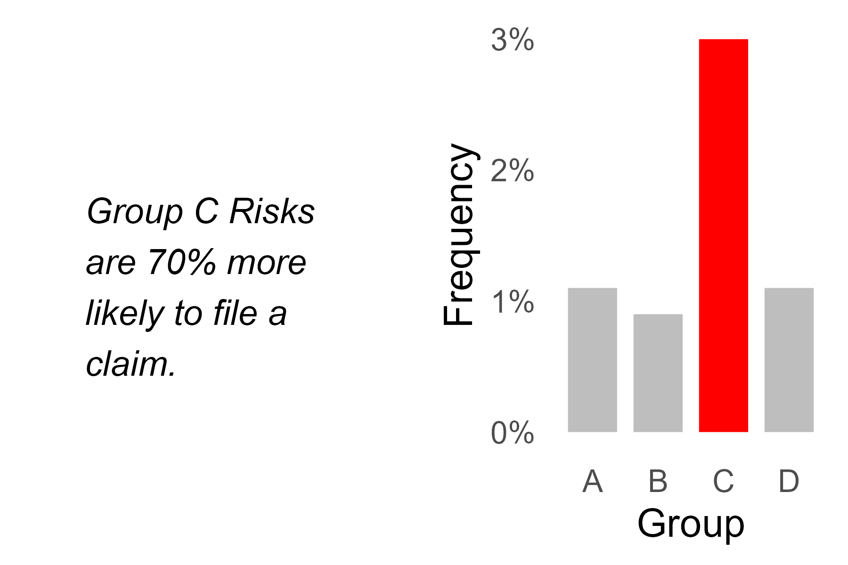
Memory Retention

Slide 16
Decoding Complexity

Slide 17
Decoding Complexity
Univariate Linear Regression
Principal Components Analysis
Decision Trees
Correlation & Tail Correlation

Slide 18
The Power of Persuasion

Slide 19
The Power of Persuasion
Highlighting Key Insights
Telling a Story
Providing Context
Show Comparisons

Slide 20
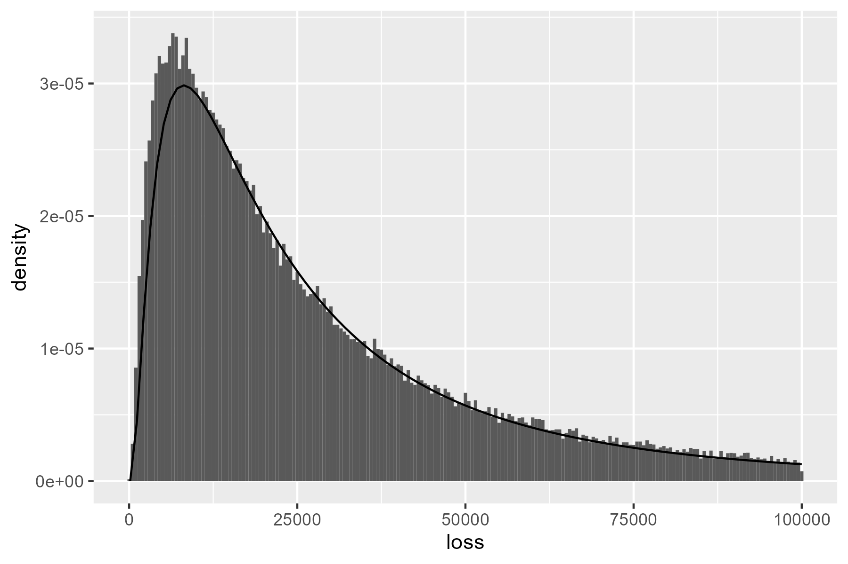
Initial Example: Fitted Severity
How can we improve upon this chart?
p <- data |>
geom_histogram(aes(x = loss, after_stat(density)) +
stat_function(fun = dlnorm,
args = list(meanlog = 10, sdlog = 1.0))

Slide 21
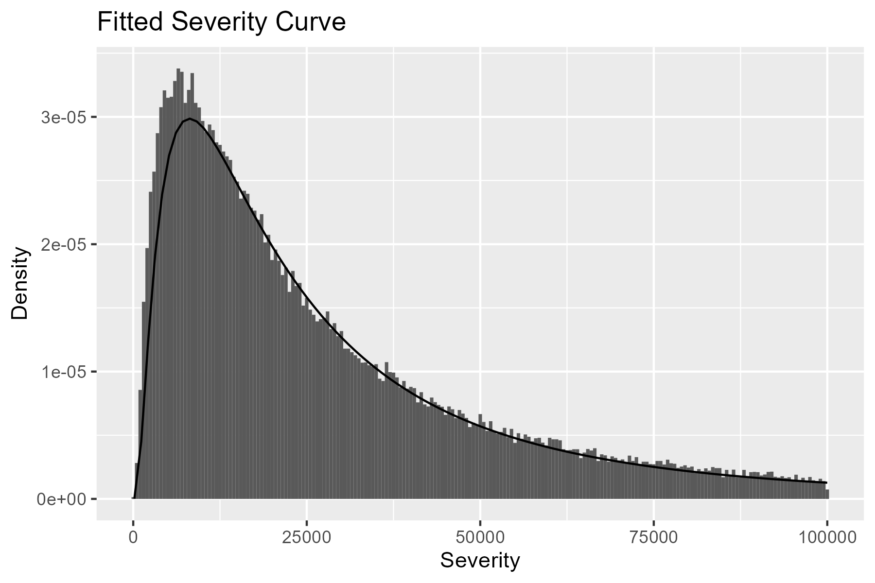
Titles & Renaming Variables
Adding a title and variable names goes a long way.
p <- p +
labs(
x = "Severity",
y = "Density",
title = "Fitted Severity Curve"
)

Slide 22
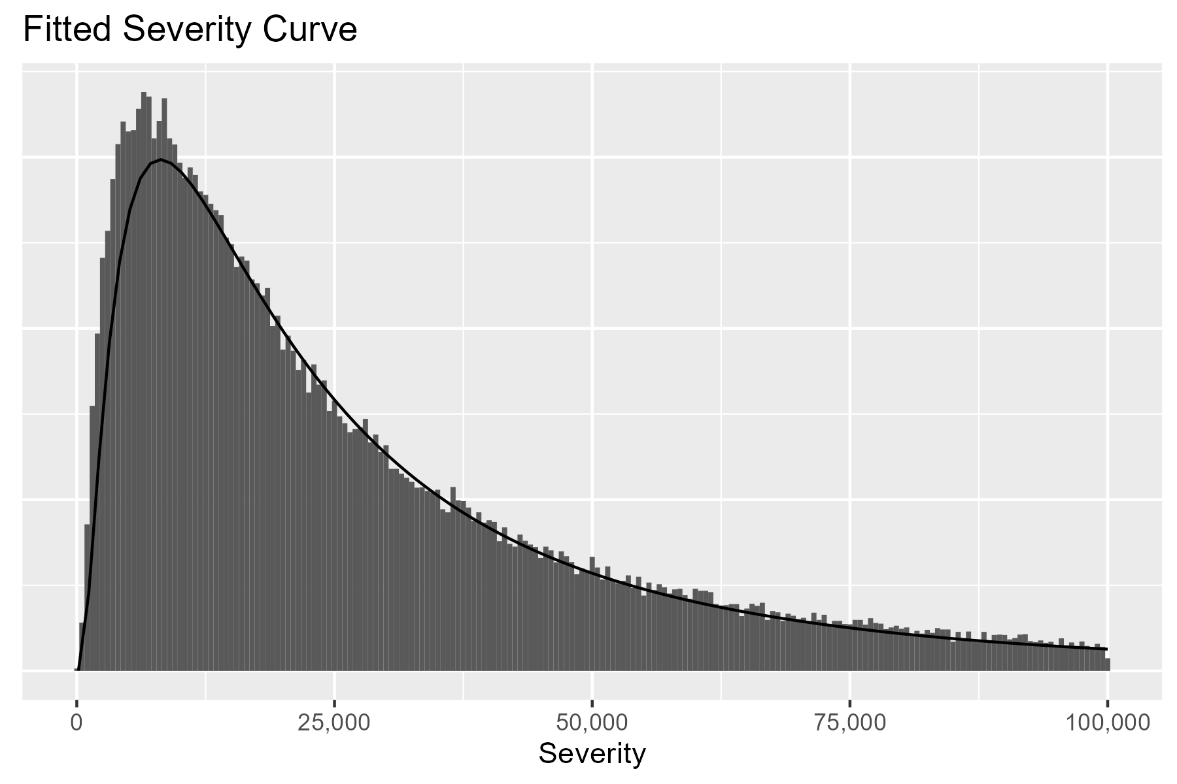
Cleaning Axes
We can change the x-axis labels and remove the y-axis.
p <- p +
scale_x_continuous(labels = scales::comma) +
theme(axis.text.y = element_blank(),
axis.ticks.y = element_blank(),
axis.title.y = element_blank())

Slide 23
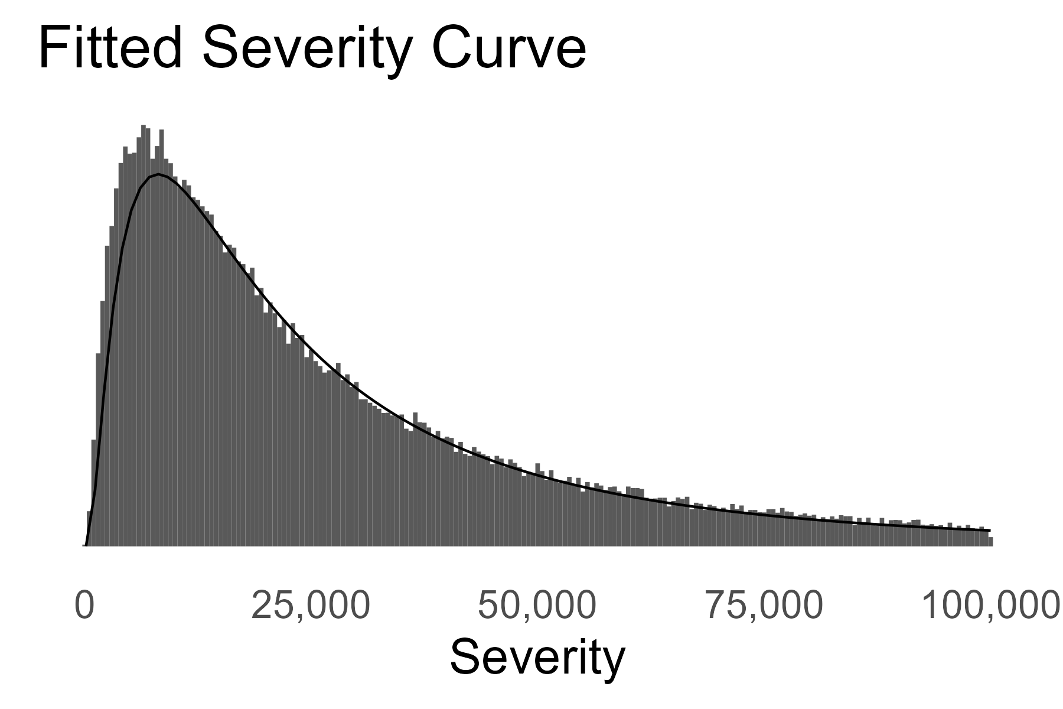
Text Size & Theme
We can increase text size and select a simpler theme.
p <- p +
theme_minimal(base_size = 20) +
theme(panel.grid.major = element_blank(),
panel.grid.minor = element_blank()) +
scale_x_continuous(labels = scales::comma) +
theme(axis.text.y = element_blank(),
axis.ticks.y = element_blank(),
axis.title.y = element_blank())

Slide 24
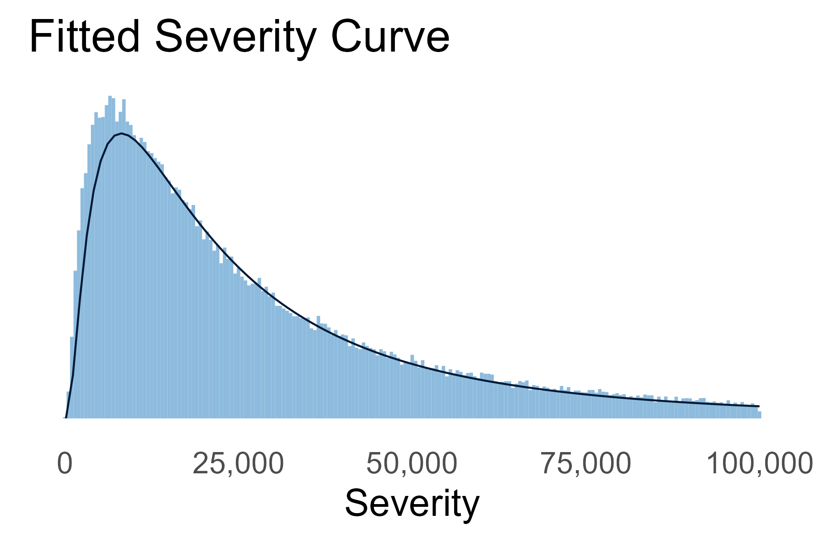
Color
We can also update the color, if desired.
...
geom_histogram(aes(x = loss, after_stat(density)),
fill = pal_CAS["light_blue"]) +
stat_function(fun = dlnorm,
args = list(meanlog = 10, sdlog = 1.0),
color = pal_CAS["dark_blue"]) +
...

Slide 25

Comparison

Slide 27
Appendix

Slide 28
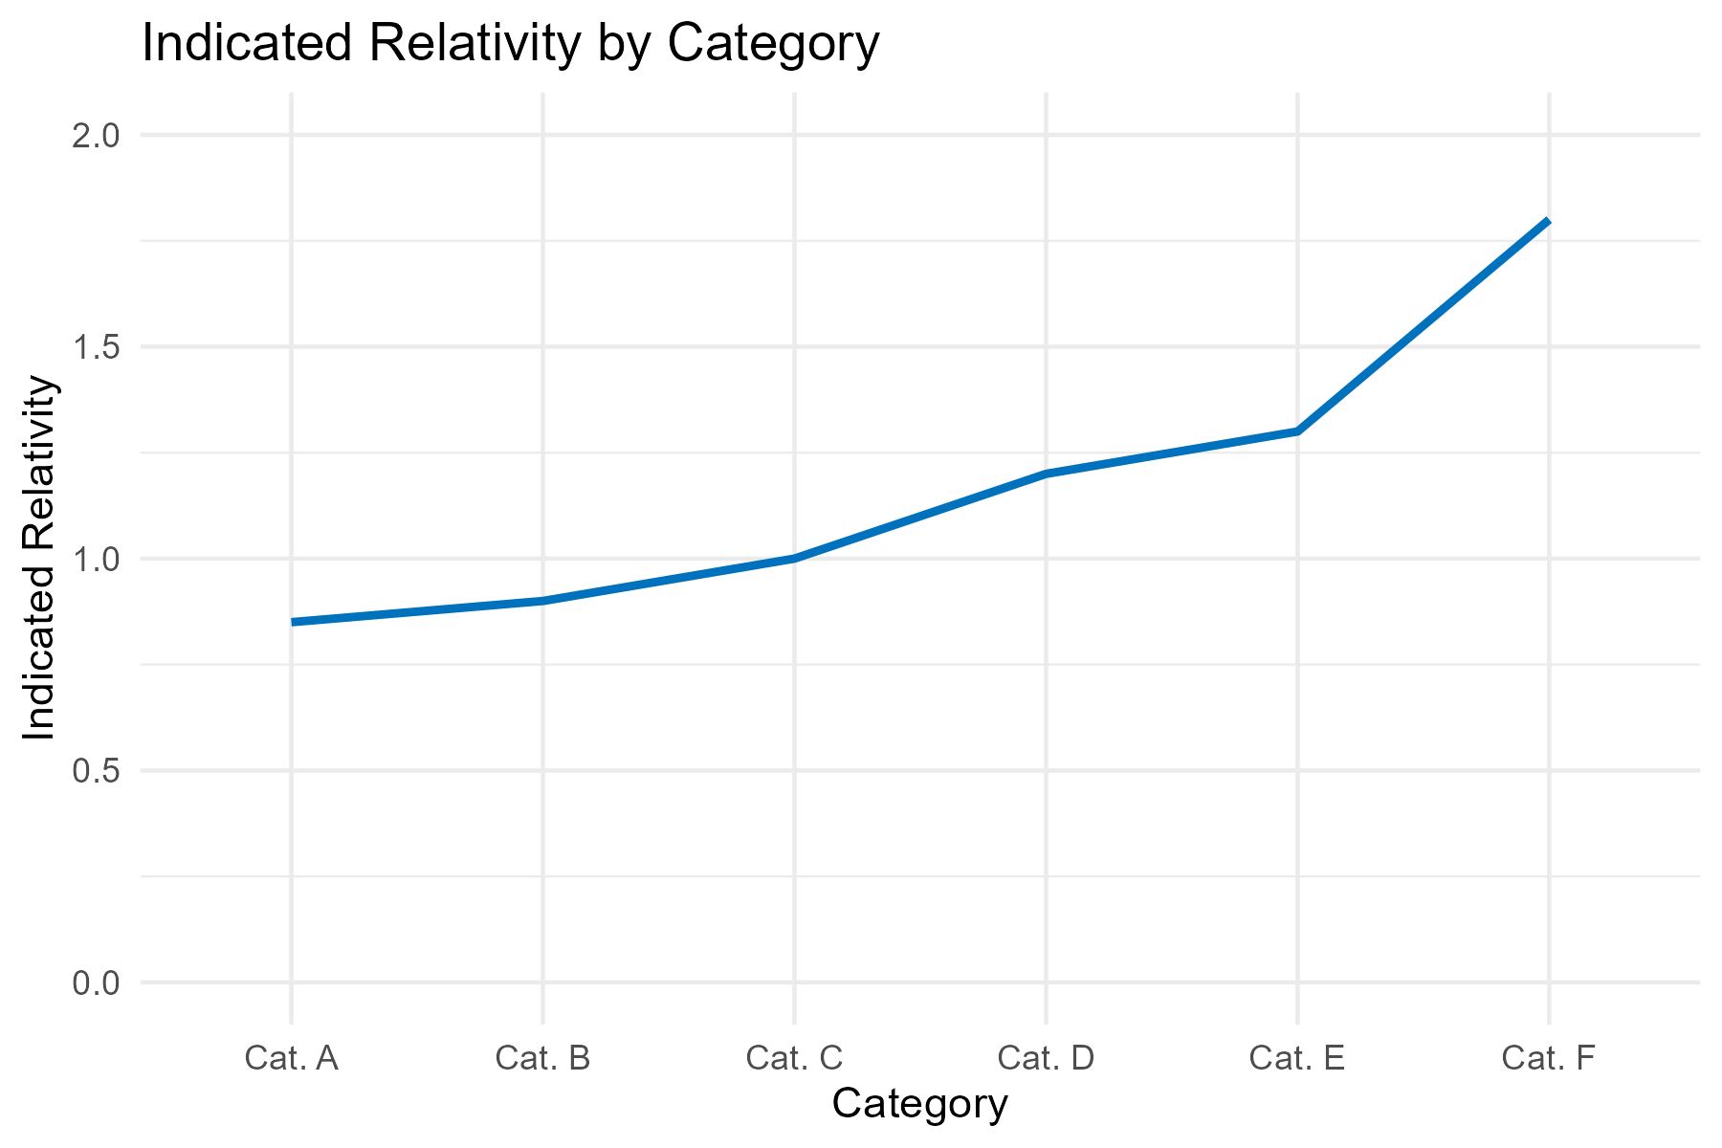
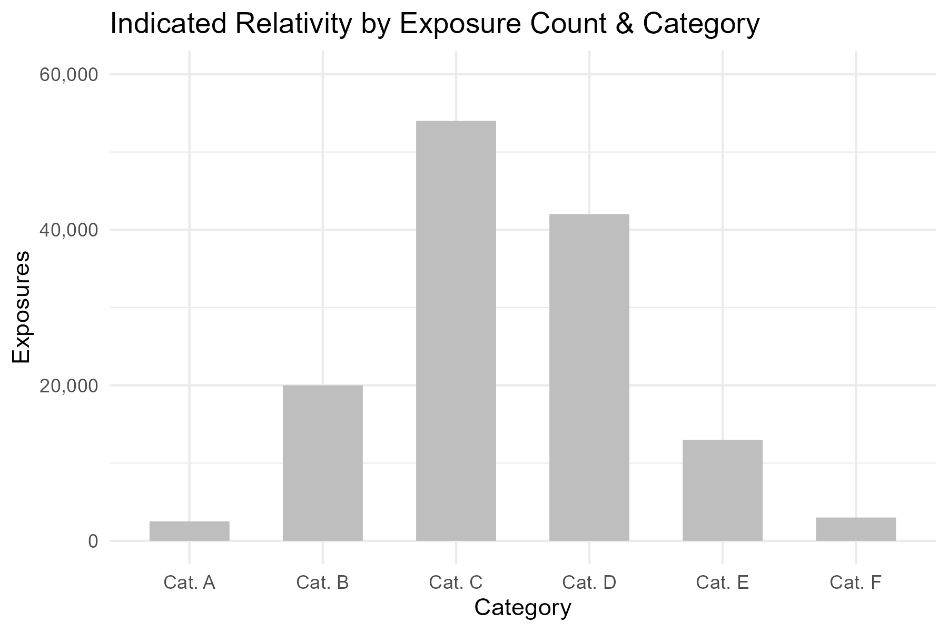
Two Axes vs Two Charts

Slide 29
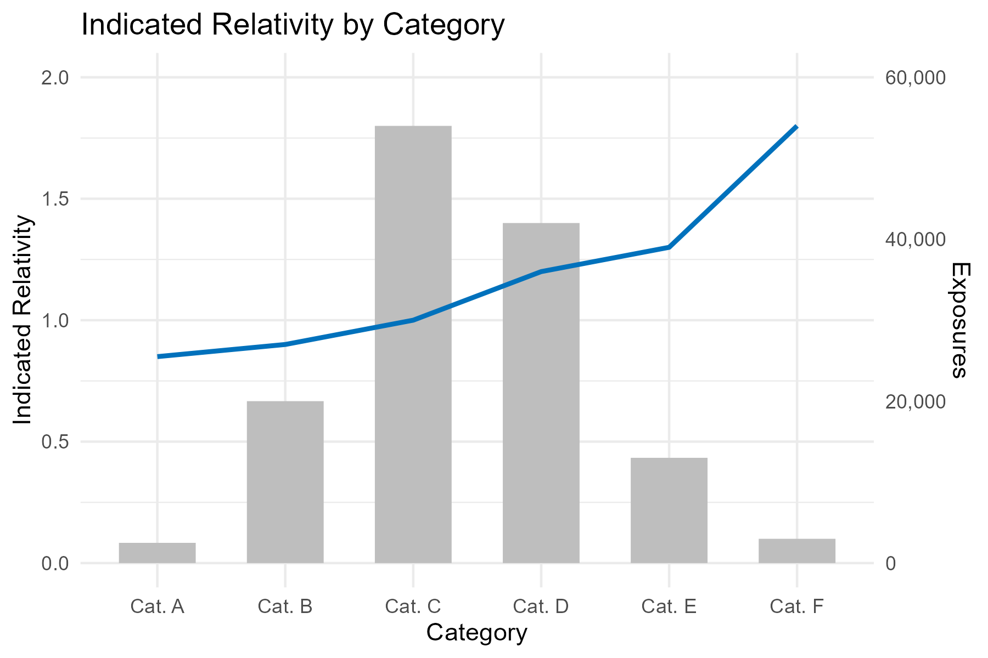
Two Axes vs Two Charts

Slide 30
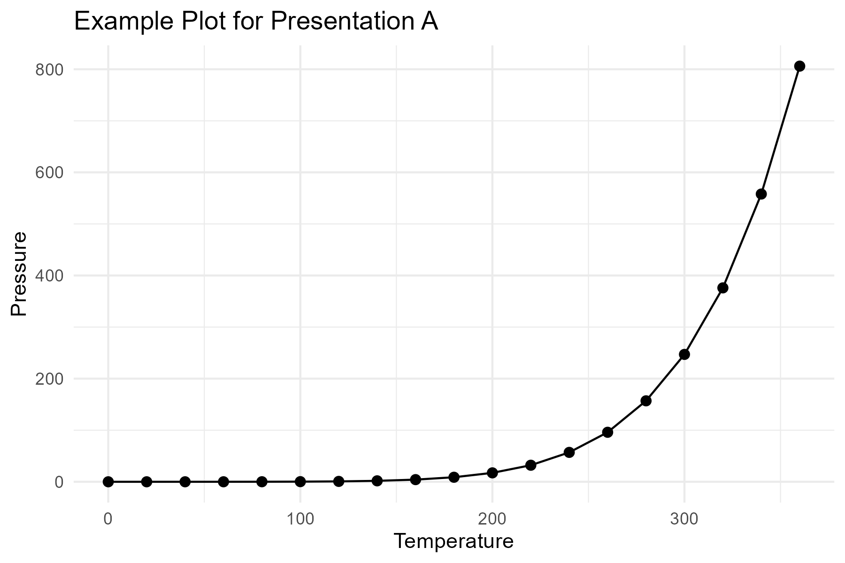
Example Plot A

Slide 31
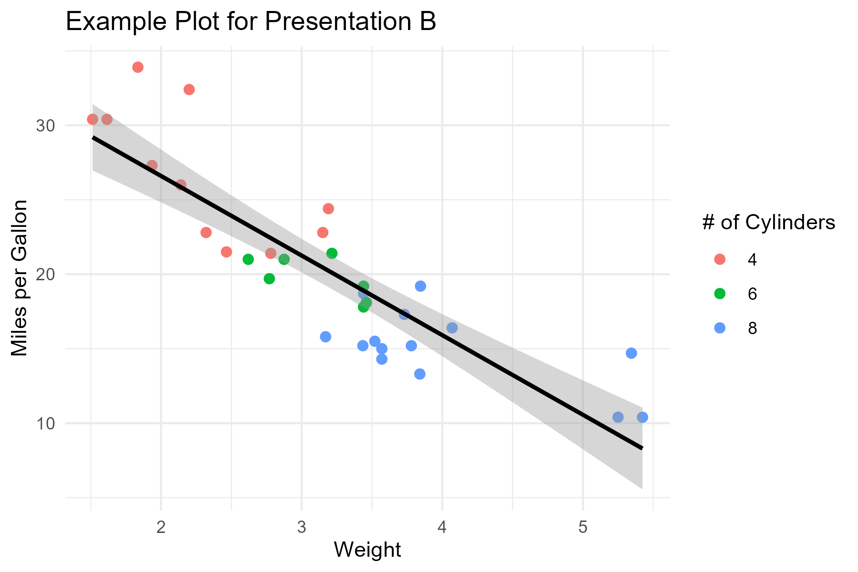
Example Plot B

Slide 32
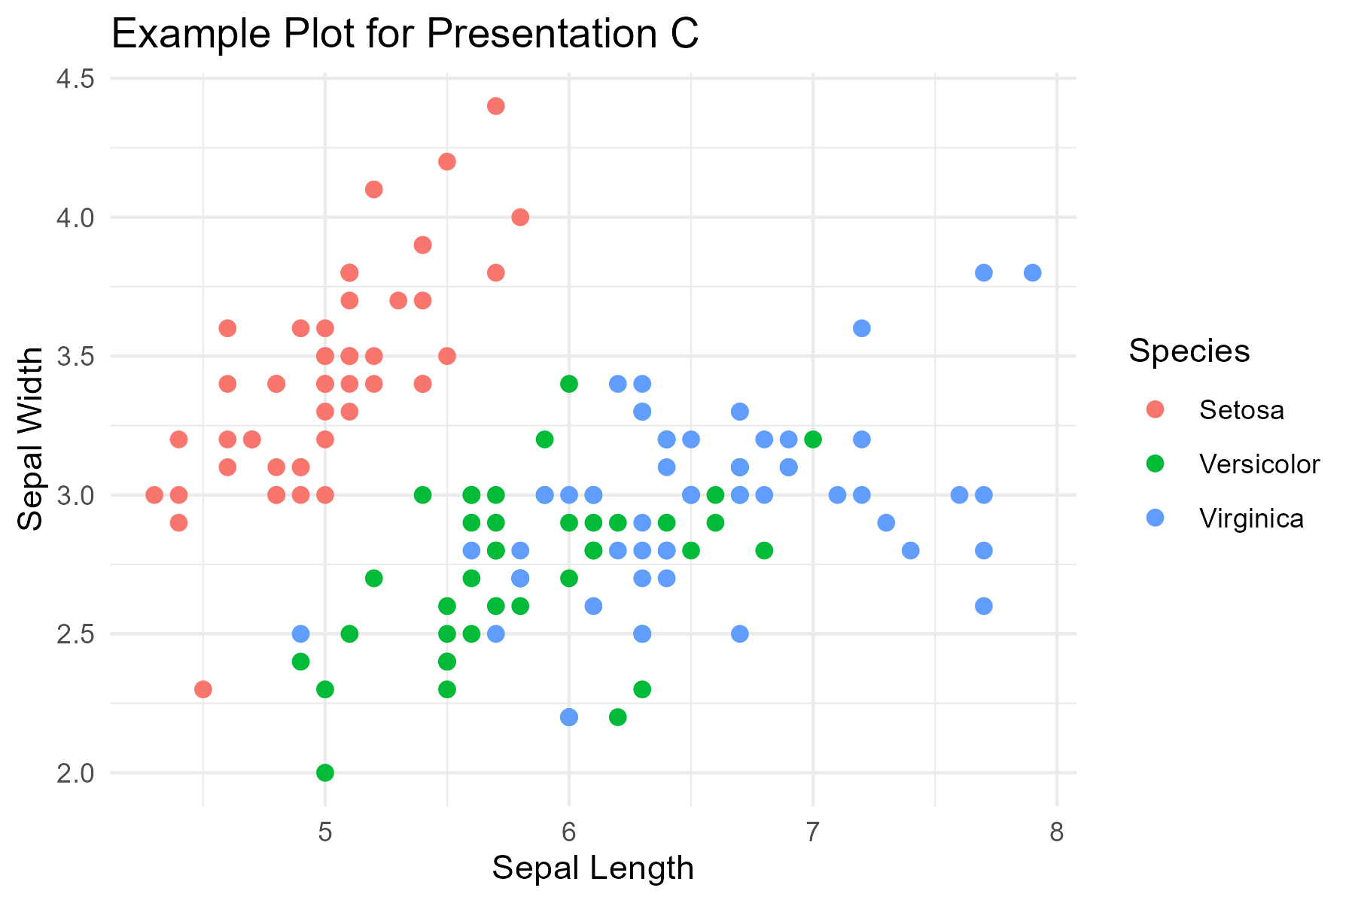
Example Plot C

